Slide 1
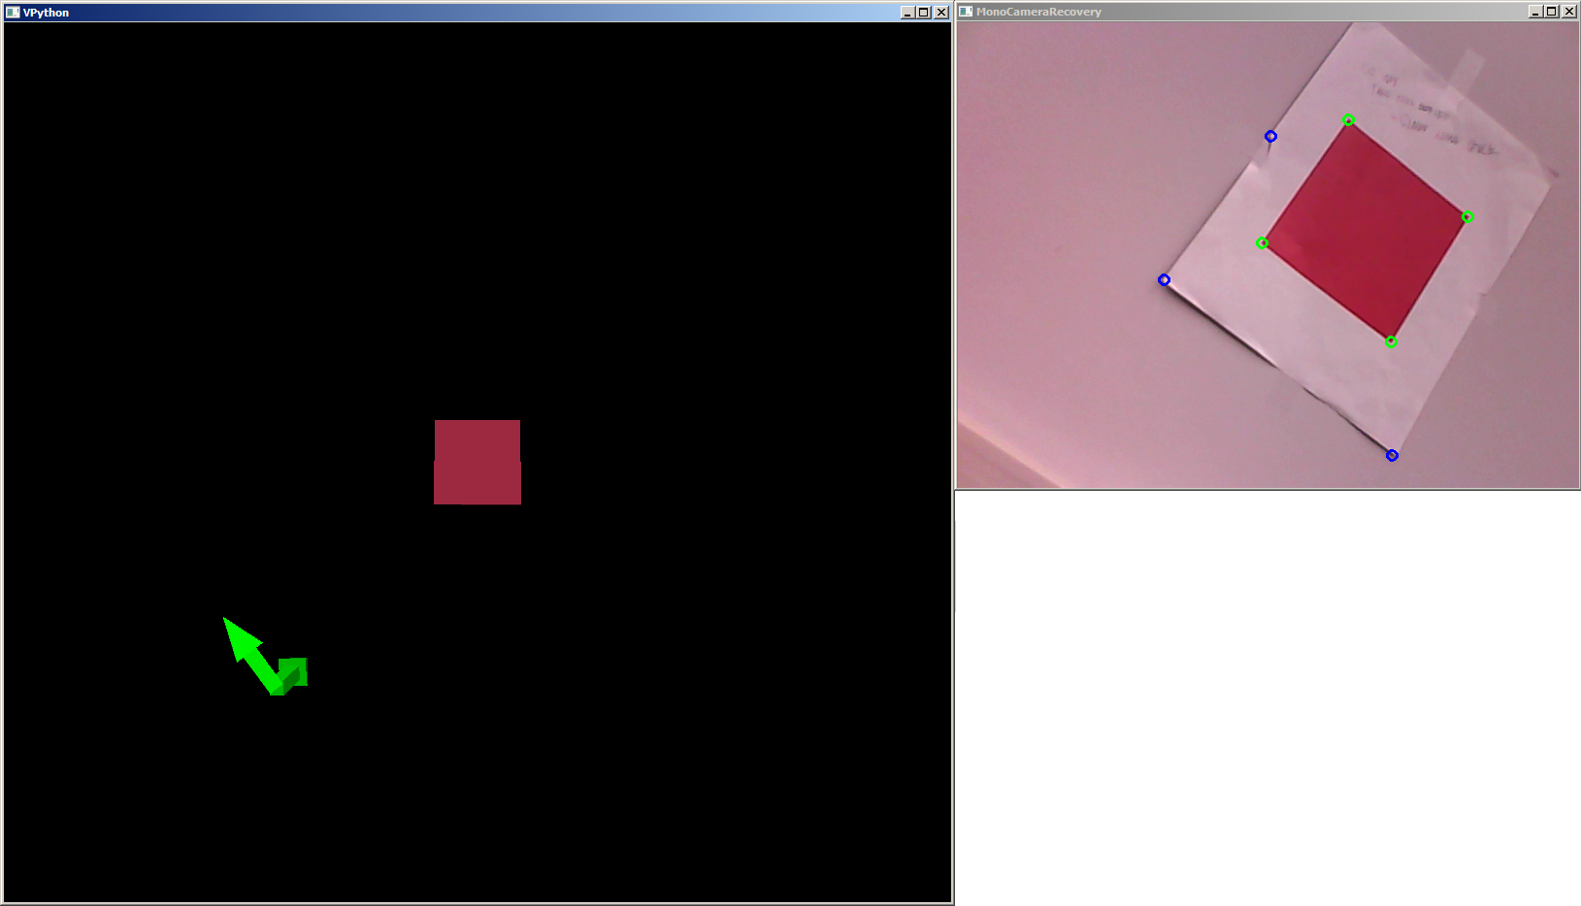
RECOVERING 3D INFORMATION WITH A SINGLE CAMERA
Haoran Liang (Simon)
Multidisciplinary Minor in Imaging
Final Project Presentation
Notes:
Photo of project/demo.
Multidisciplinary Minor in Imaging
Final Project Presentation

Slide 2
Overview
Why/How it works
Procedure
Demo
Future Improvements
Q&A

Slide 3

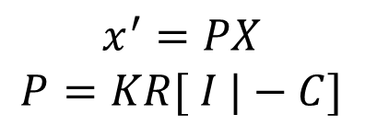
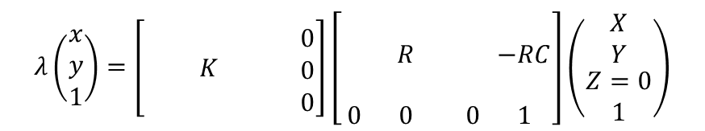
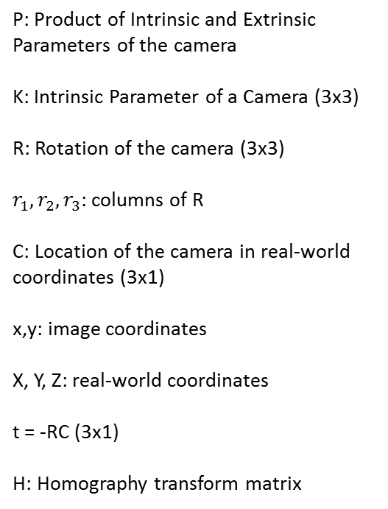


If we know the size of the object and intrinsic properties of a camera, we can recover 3D information with just one camera
P: Product of Intrinsic and Extrinsic Parameters of the camera
K: Intrinsic Parameter of a Camera (3x3)
R: Rotation of the camera (3x3)
$r_{1}, r_{2}, r_{3}$: columns of R
C: Location of the camera in real-world coordinates (3x1)
x,y: image coordinates
X, Y, Z: real-world coordinates
t = -RC (3x1)
H: Homography transform matrix
$$x^{′}=PX$$
$$P=KR[ I |−C]$$
$$λ\left(\begin{matrix}x \\ y \\ 1\end{matrix}\right)=\left[\begin{matrix} & & \begin{matrix} & 0\end{matrix} \\ & K & \begin{matrix} & 0\end{matrix} \\ & & \begin{matrix} & 0\end{matrix}\end{matrix}\right]\left[\begin{matrix}\begin{matrix} & \\ & R\end{matrix} & \begin{matrix} & \\ & −RC\end{matrix} \\ \begin{matrix} & \\ 0 & 0\end{matrix} & \begin{matrix} & \\ 0 & 1\end{matrix}\end{matrix}\right]\left(\begin{matrix}X \\ Y \\ \begin{matrix}Z=0 \\ 1\end{matrix}\end{matrix}\right)$$
$$λ\left(\begin{matrix}x \\ y \\ 1\end{matrix}\right)=K\left[\begin{matrix} & & \\ r_{1} & r_{2} & t \\ & & \end{matrix}\right]\left(\begin{matrix}X \\ Y \\ 1\end{matrix}\right)$$
$$K\left[\begin{matrix} & & \\ r_{1} & r_{2} & t \\ & & \end{matrix}\right]=H$$
$$x^{′}=Hx$$
Our goal is to solve R and C, knowing K, H and corresponding sets of points (x, y) -> (X, Y, Z=0)
Source: JP Mellor, CSSE 461 Computer Vision, and
http://www.epixea.com/research/multi-view-coding-thesisse9.html
Notes:
Key: Know intrinsic params of the camera, real-world (size of square)
Need a list of what each variable means, including K.
Insert a slide after showing visual example of as many of the params as possible.

Slide 4
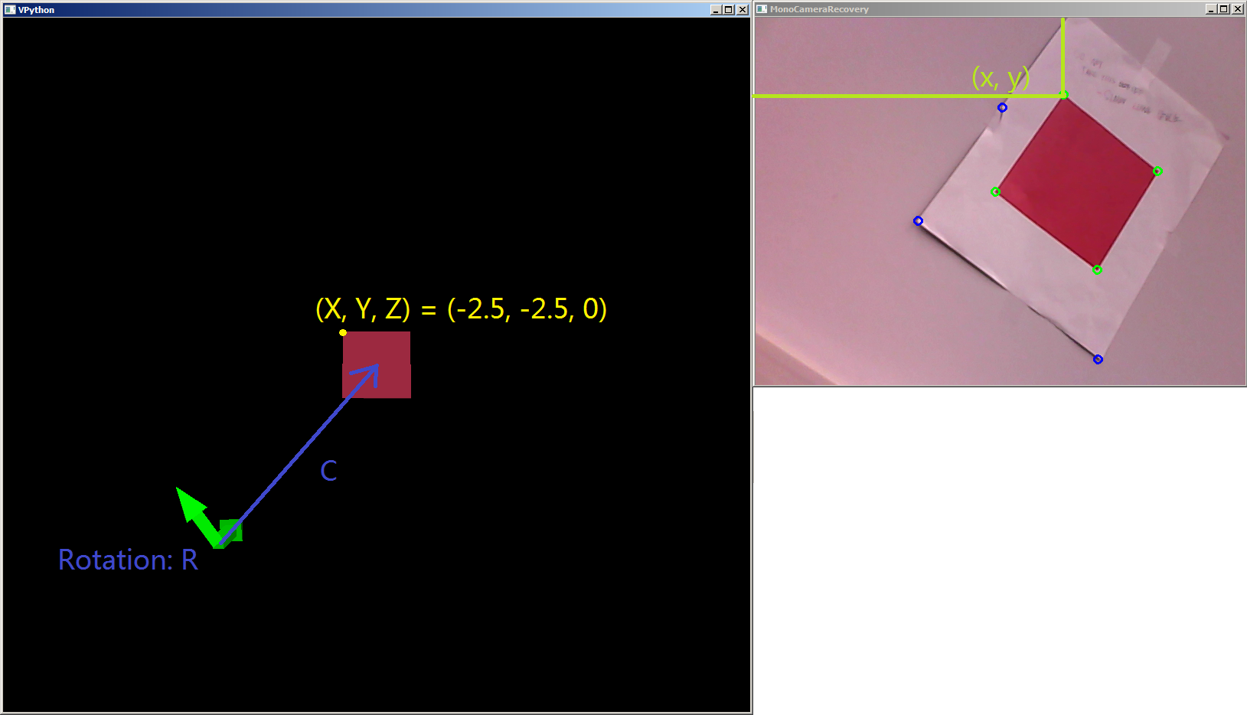
Visual Example

Slide 5
Procedure
Camera Calibration
Camera Capture Image
Filter Red Square
Corner Detection
Find Homography
Find Camera Center

Slide 6
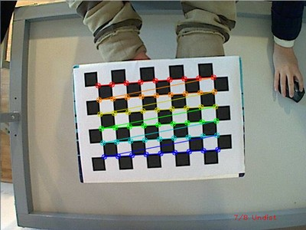
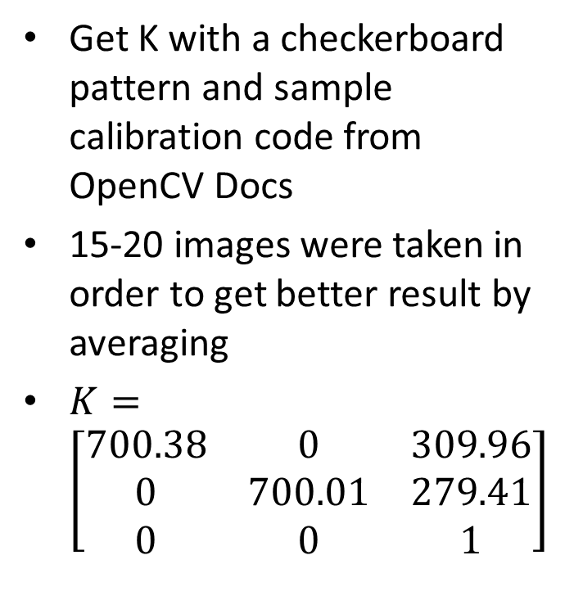
Camera Calibration
Get K with a checkerboard pattern and sample calibration code from OpenCV Docs
15-20 images were taken in order to get better result by averaging
$K=\left[\begin{matrix}700.38 & 0 & 309.96 \\ 0 & 700.01 & 279.41 \\ 0 & 0 & 1\end{matrix}\right]$
Source: http://docs.opencv.org/doc/tutorials/calib3d/camera_calibration/camera_calibration.html
Notes:
Explain K

Slide 7
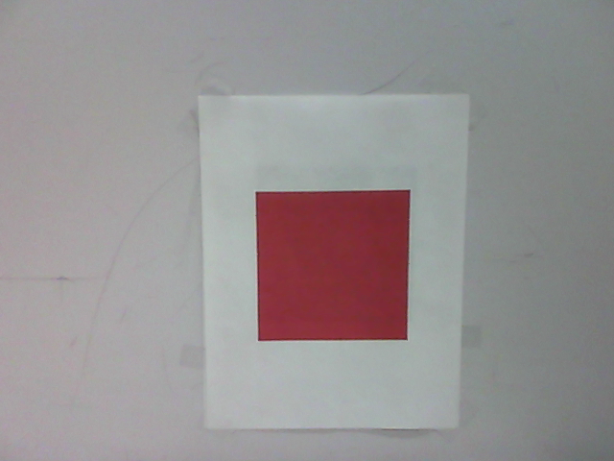
Camera Capture Image
Use OpenCV’s Python bindings
Much faster and more memory efficient compared to the equivalent MATLAB project
Notes:
More memory efficient because MATLAB has to allocate the memory for the camera stream and it does not automatically clear old image cache. OpenCV has better memory management on this regard (old images gets freed in memory)

Slide 8
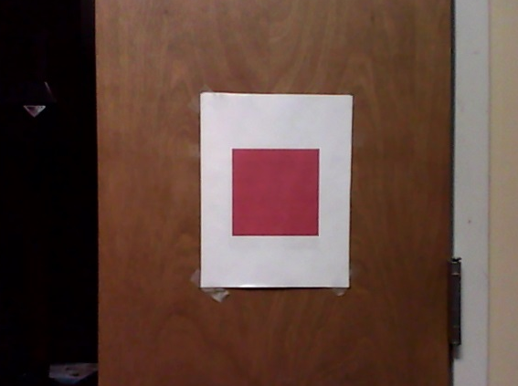
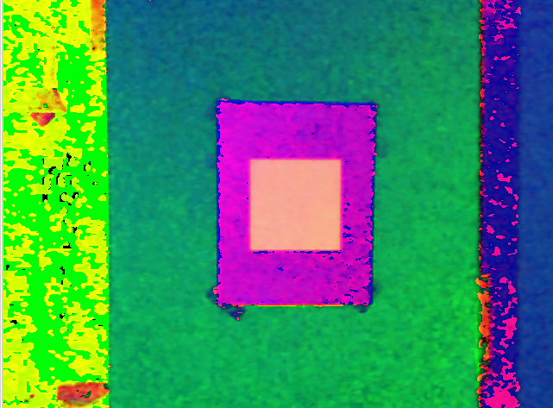
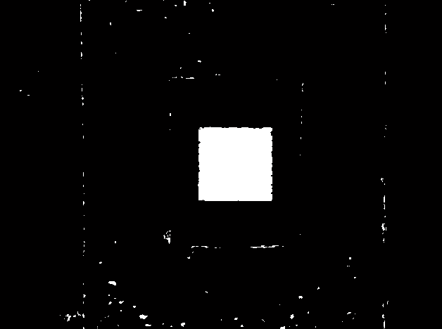

Filter Red Square
Convert RGB (Red/Green/Blue) to HSV (Hue/Saturation/Value)
Build binary mask of the image Based on the Hue, Saturation and Value thresholds of the red square color
Get rid of small noise by counting the # of pixels (contour area in terms of OpenCV) for each connected component
Source: Matt Boutell, CSSE 463 Image Recognition
Notes:
Use the OpenCV input interface to dynamically collect color so that the program can adaptively set the red mask

Slide 9
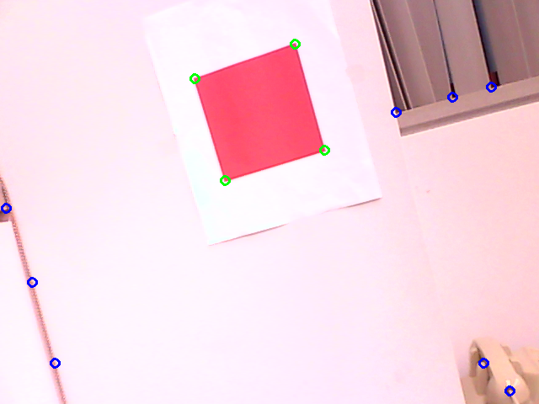

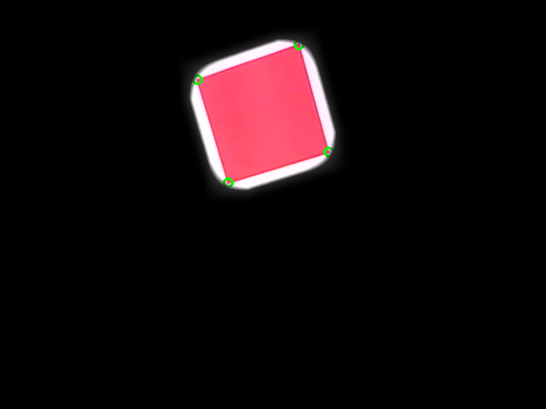
Corner Detection
Find all the possible Corners in the picture using Harris Corner Detection Algorithm
Uses blue-color channel to improve contrast to red square
If the corner candidates land on the red square filter, keep them
Blur the red square mask to improve accuracy
Notes:
Discuss Harris = eigenvalues of covariance matrix of window at each point in image. Corners when both eigs are large. (Ref wikipedia: http://en.wikipedia.org/wiki/Corner_detection)
Blur: to make red region larger so can take corners inside the larger red region.

Slide 10
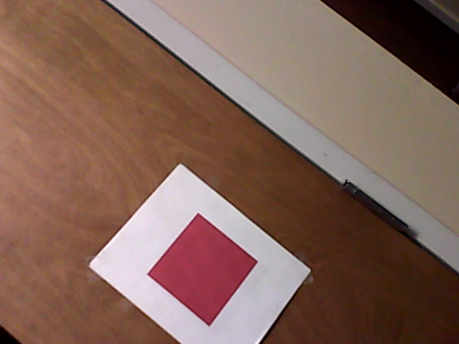
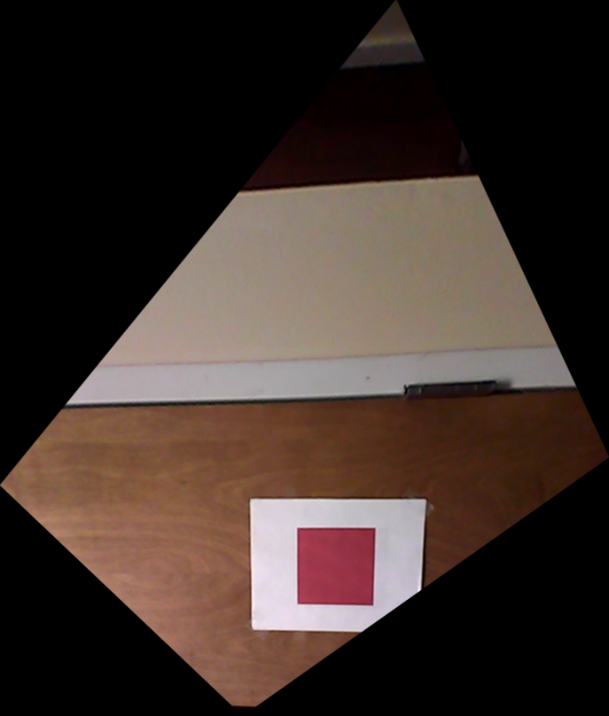
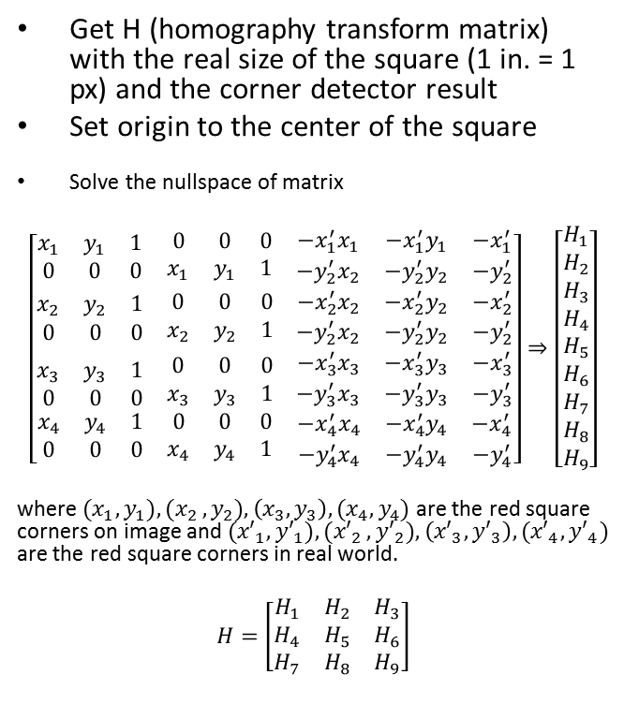
Find homography
Get H (homography transform matrix) with the real size of the square (1 in. = 1 px) and the corner detector result
Set origin to the center of the square
Solve the nullspace of matrix
$$\left[\begin{matrix}\begin{matrix}x_{1} & y_{1} & 1 \\ 0 & 0 & 0\end{matrix} & \begin{matrix}0 & 0 & 0 \\ x_{1} & y_{1} & 1\end{matrix} & \begin{matrix}−x_{1}^{′}x_{1} & −x_{1}^{′}y_{1} & −x_{1}^{′} \\ −y_{2}^{′}x_{2} & −y_{2}^{′}y_{2} & −y_{2}^{′}\end{matrix} \\ \begin{matrix}x_{2} & y_{2} & 1 \\ 0 & 0 & 0\end{matrix} & \begin{matrix}0 & 0 & 0 \\ x_{2} & y_{2} & 1\end{matrix} & \begin{matrix}−x_{2}^{′}x_{2} & −x_{2}^{′}y_{2} & −x_{2}^{′} \\ −y_{2}^{′}x_{2} & −y_{2}^{′}y_{2} & −y_{2}^{′}\end{matrix} \\ \begin{matrix}\begin{matrix}x_{3} & y_{3} & 1 \\ 0 & 0 & 0\end{matrix} \\ \begin{matrix}x_{4} & y_{4} & 1 \\ 0 & 0 & 0\end{matrix}\end{matrix} & \begin{matrix}\begin{matrix}0 & 0 & 0 \\ x_{3} & y_{3} & 1\end{matrix} \\ \begin{matrix}0 & 0 & 0 \\ x_{4} & y_{4} & 1\end{matrix}\end{matrix} & \begin{matrix}\begin{matrix}−x_{3}^{′}x_{3} & −x_{3}^{′}y_{3} & −x_{3}^{′} \\ −y_{3}^{′}x_{3} & −y_{3}^{′}y_{3} & −y_{3}^{′}\end{matrix} \\ \begin{matrix}−x_{4}^{′}x_{4} & −x_{4}^{′}y_{4} & −x_{4}^{′} \\ −y_{4}^{′}x_{4} & −y_{4}^{′}y_{4} & −y_{4}^{′}\end{matrix}\end{matrix}\end{matrix}\right]⇒\left[\begin{matrix}\begin{matrix}H_{1} \\ H_{2} \\ H_{3}\end{matrix} \\ \begin{matrix}H_{4} \\ H_{5} \\ H_{6}\end{matrix} \\ \begin{matrix}H_{7} \\ H_{8} \\ H_{9}\end{matrix}\end{matrix}\right]$$
where ${(x}_{1}, y_{1}){,(x}_{2}, y_{2}),\left(x_{3},y_{3}\right),(x_{4},y_{4})$ are the red square corners on image and ${(x′}_{1}, {y′}_{1}){,(x′}_{2}, {y′}_{2}),\left({x′}_{3},{y′}_{3}\right),({x′}_{4},{y′}_{4})$ are the red square corners in real world.
$$H=\left[\begin{matrix}H_{1} & H_{2} & H_{3} \\ H_{4} & H_{5} & H_{6} \\ H_{7} & H_{8} & H_{9}\end{matrix}\right]$$
Homography Transform

Slide 11



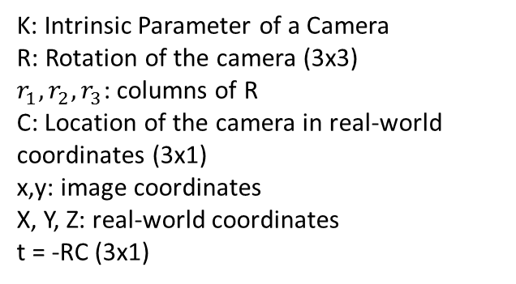
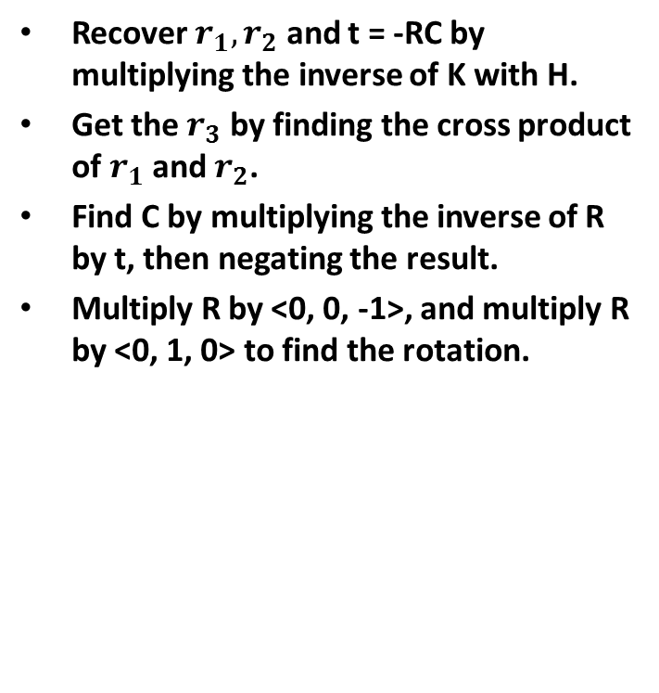


Apply the Math
$$x^{′}=PX$$
$$P=KR[ I |−C]$$
Recover $r_{1}, r_{2}$ and t = -RC by multiplying the inverse of K with H.
Get the $r_{3}$ by finding the cross product of $r_{1}$ and $r_{2}$.
Find C by multiplying the inverse of R by t, then negating the result.
Multiply R by <0, 0, -1>, and multiply R by <0, 1, 0> to find the rotation.
$$x^{′}=Hx$$
K: Intrinsic Parameter of a Camera
R: Rotation of the camera (3x3)
$r_{1}, r_{2}, r_{3}$: columns of R
C: Location of the camera in real-world coordinates (3x1)
x,y: image coordinates
X, Y, Z: real-world coordinates
t = -RC (3x1)

Slide 12
Live Demo

Slide 13
Future Improvements
Rotation Matrix and Position Vector
Raw result is partially flipped
For R, I needed to extract the Eulerian angles, and rebuild R based on the flipped rotations.
Wonder if there’s a cleaner way to get the exact transform
Use continuity of video stream to improve corner detection
Keeps track of the corners so the rotation can be in 360 degrees

Slide 14
Any Questions?
Thank You!
GitHub Repository: https://github.com/lhr0909/MonoCameraRecovery
Youtube Video of the demo: http://youtu.be/wXrEu-Yz1ko
Presentation Slides and Final Report Available in the Repository

